Slide 1

BlackTech Pizza Annual Report
2015
by Priscilla Aihoon

Slide 2
Objective
Business Questions
Executive Summary
Sales Analysis
Product Analysis
Key Insights
Recommendations
Agenda

Slide 3
Improve Operations
Report
Objective
Boost Sales
Optimize Products
Increase Revenue

Slide 4
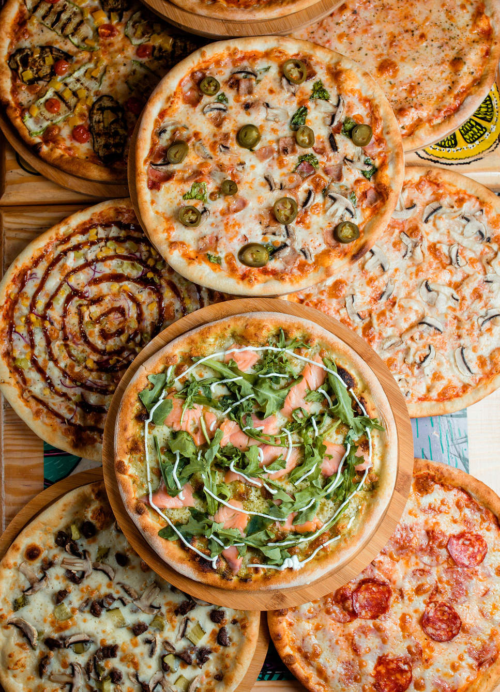


Questions
Which pizza categories, products, and sizes contribute most to overall sales and revenue?
What are the peak times, and how can operations adjust to meet it?
Which pizzas are underperforming, and should they be rebranded, promoted, or removed?
What opportunities exist to increase revenue?
Hypothesis
Large pizza categories generate the majority revenue.
Sales peak on weekends and evenings.
Some pizzas underperform and may need streamlining.
Bundling and weekend promotions could boost revenue.

Slide 5

Executive Summary

Slide 6
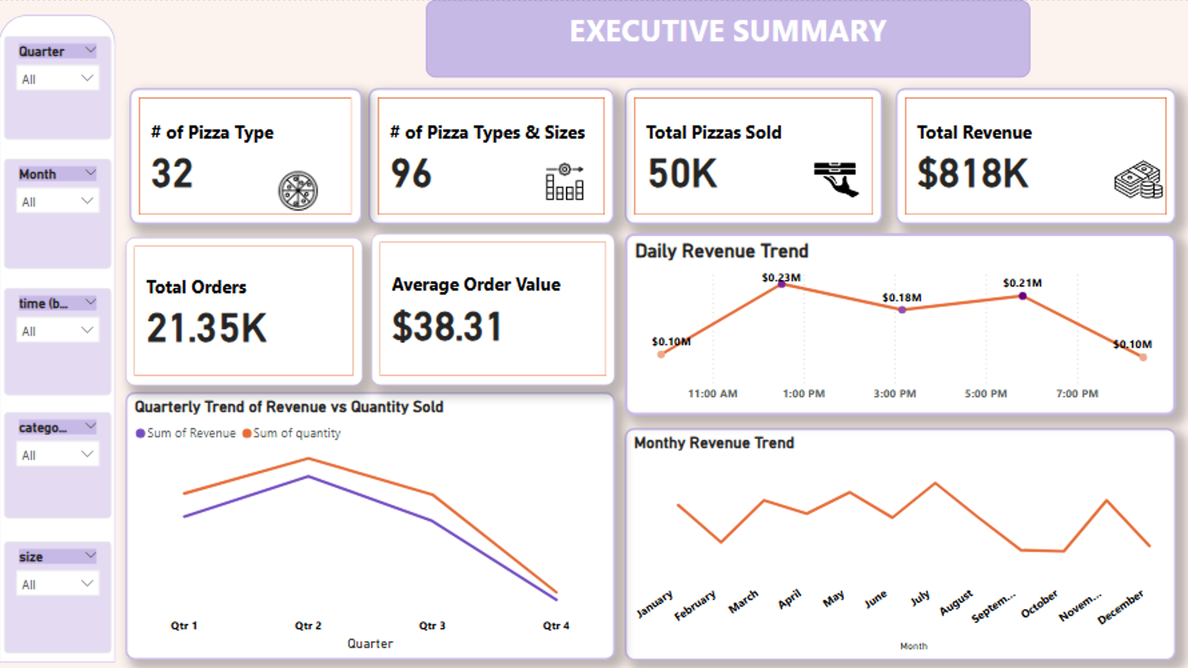

Slide 7

Sales Analysis

Slide 8
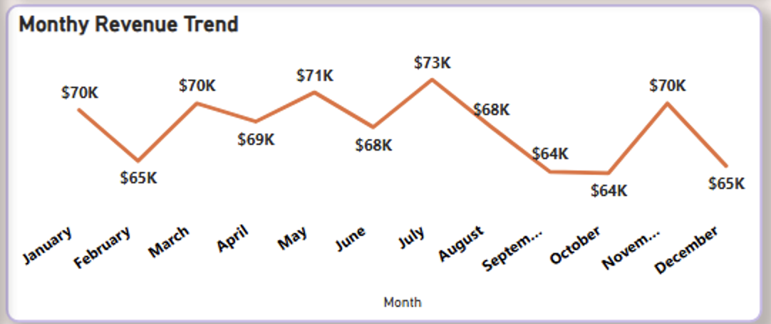
Revenue
Annual sales

Slide 9
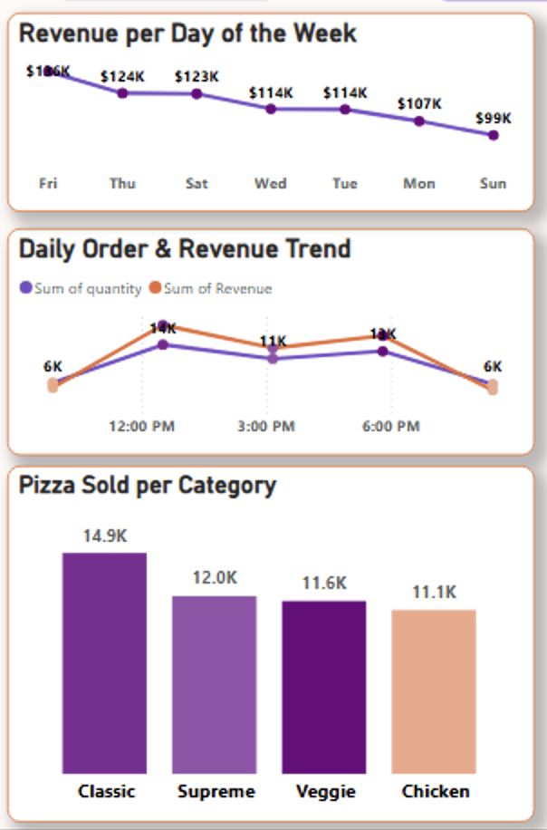
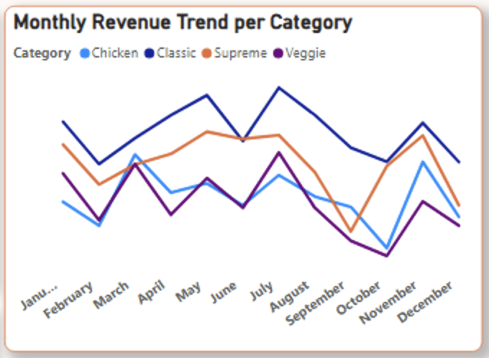
Revenue
Trend

Slide 10
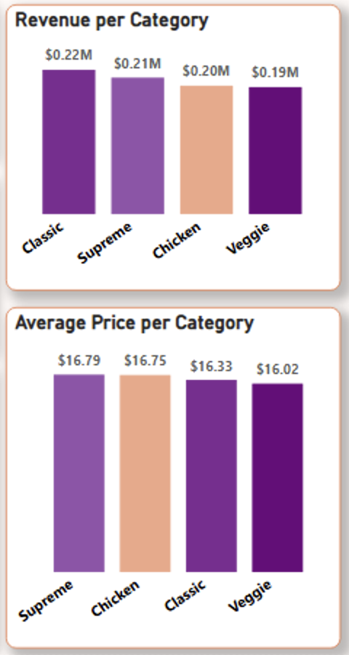
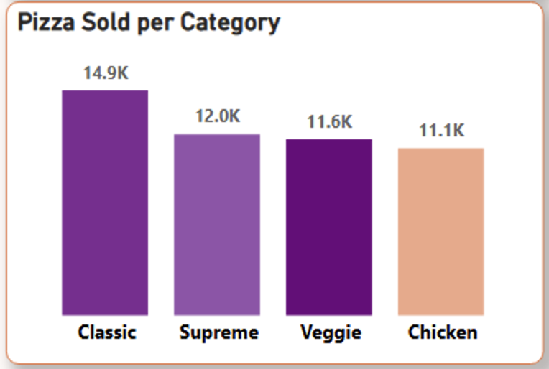
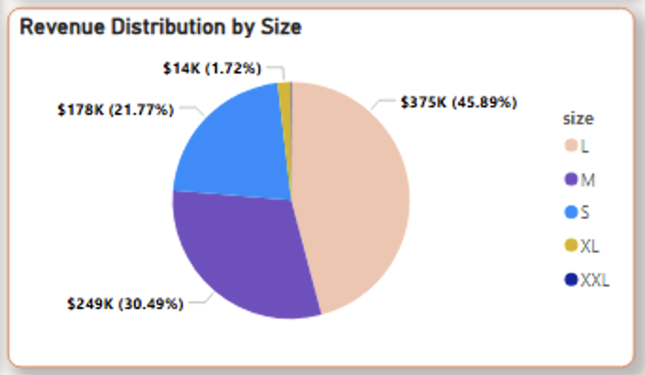
Revenue
By Category

Slide 11
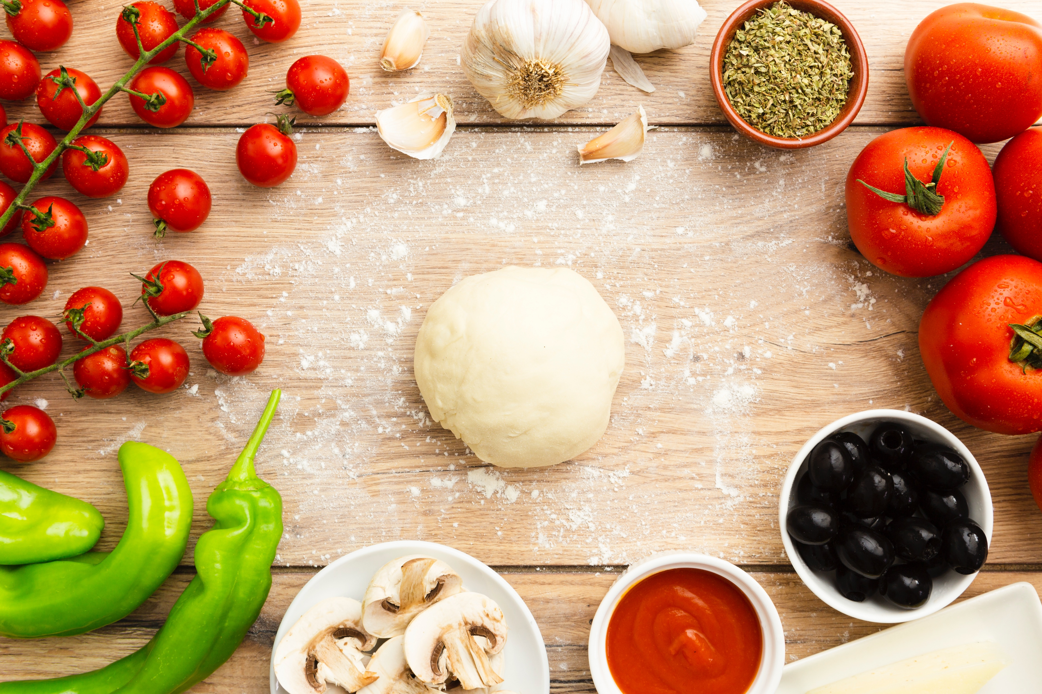
Product Analysis

Slide 12
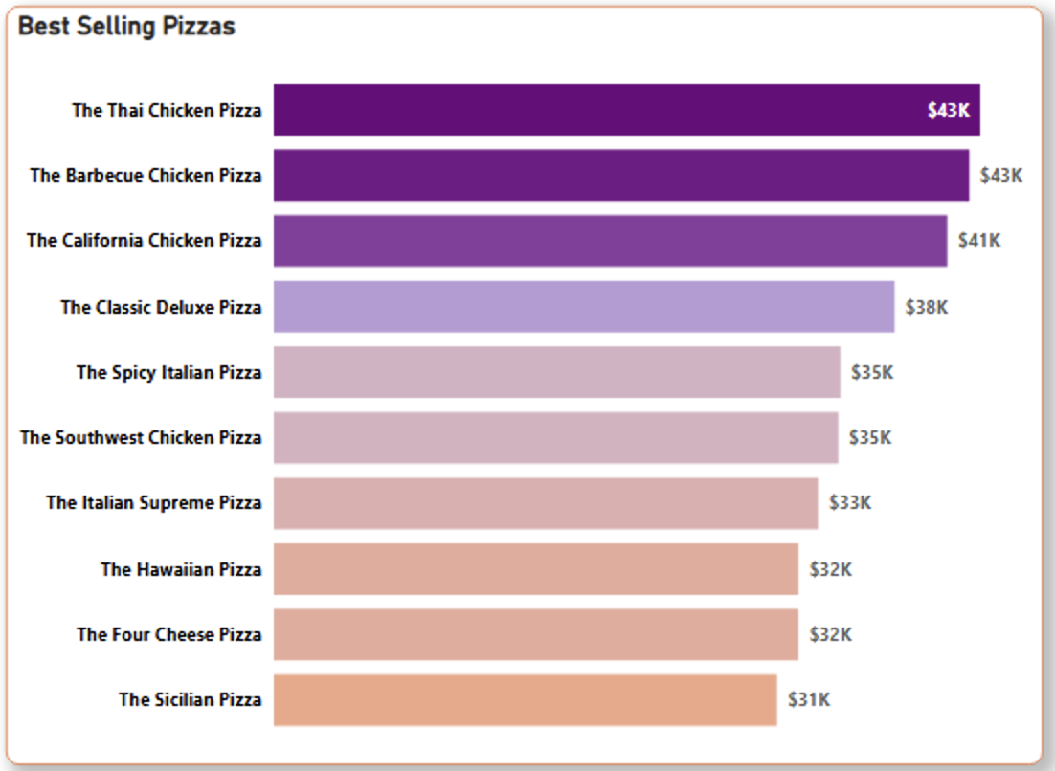
Best
Selling

Slide 13
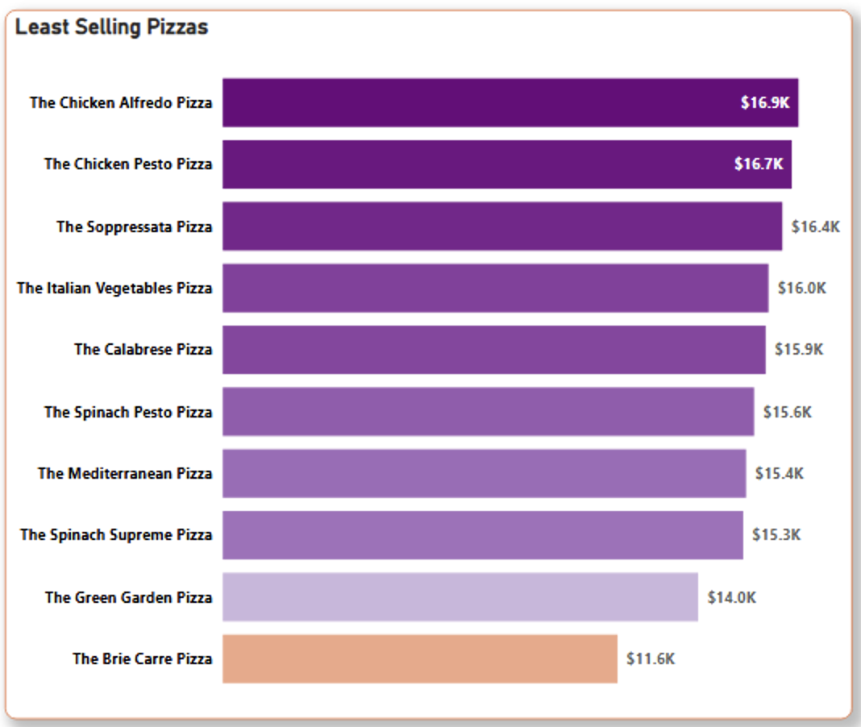
Least
Selling

Slide 14
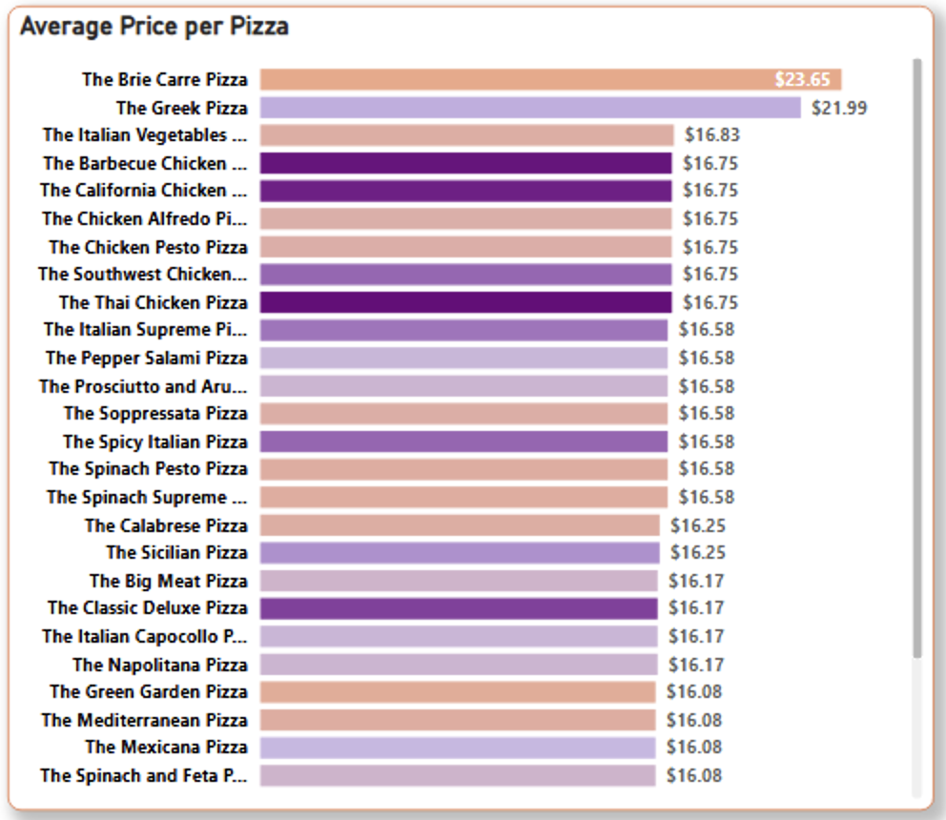
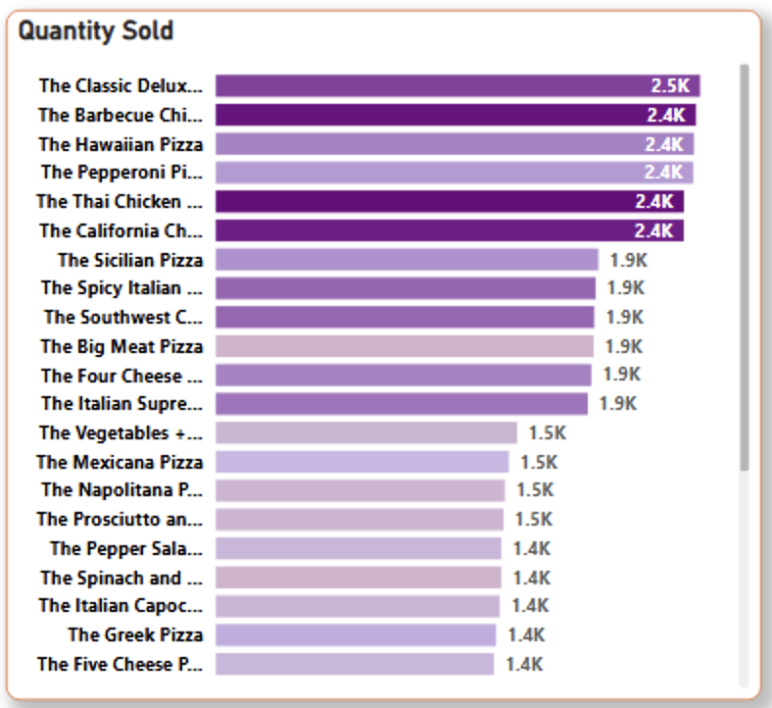
Pizza types

Slide 15
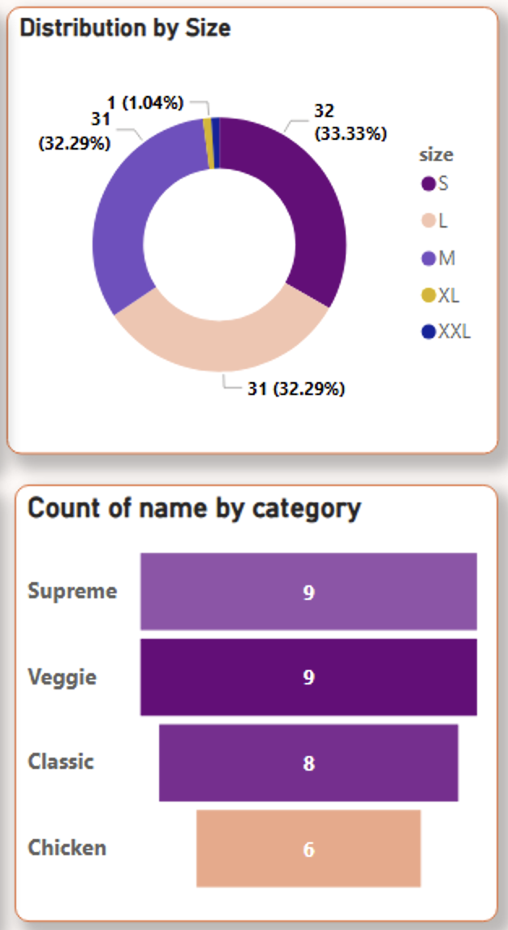
Product Category

Slide 16
Key Insights & Recommendations
Key Insights
Recommendations
Pizza categories and sizes driving sales
Classic pizzas lead with $220K revenue and 14.9K units sold, confirming they are core products.
Large pizzas dominate (46% of revenue), confirming that size drives revenue
Peak demand periods
Sales peak on Fridays, Thursdays and Saturdays and during lunch and evenings
Underperforming pizzas
Products like Brie Carre, Spinach Supreme, and Calabrese contribute less than $16K each
Revenue optimization opportunities
A few bestsellers (Thai Chicken, Barbecue Chicken, California Chicken) generate $40K+ each, while most others lag far behind
Others
Customers pay more for premium categories, Supreme & Chicken ($16.8 ) vs Classic & Veggie ($16.2)
32 pizza types, but uneven sales suggests risks of menu bloat.
Sales are seasonal especially during Q3 & Q4
XL and XXL pizzas contribute very little to sales (<2% combined), raising questions on whether they’re worth keeping
Operations
Increase staffing and inventory from Thursdays to Saturdays, and during lunch and evenings, where demand peaks.
Reduce focus on rarely ordered sizes (XL/XXL) to save on production and supply chain complexity.
Cost for each pizza type should be captured for better analysis
Sales
Run weekend promotions or offers to maximize peak demand.
Bundling top sellers with underperformers
Push upselling at checkout to raise Average Order Value above $40.
Products
Streamline underperformers (Brie Carre, Spinach Supreme, etc.) to simplify operations and reduce waste.
Promote bestsellers (Thai Chicken, Barbecue Chicken, California Chicken) more prominently in-store and online.
Explore new recipes based on popular ingredients (chicken, BBQ, Thai flavors).
Revenue Growth
Focus marketing on Classic and Supreme categories which already account for most revenue.
Consider price adjustments on high-demand items to capture more margin.
Develop seasonal specials on top selling pizzas to increase revenue across slower months

Slide 17
New Sales Goals
Focus promotions on premium categories (Supreme & Chicken)
Streamline menu by reducing low-performing pizzas
Plan seasonal campaigns to capture Q3/Q4 demand shifts
01
02
03
04
Increase bundling & upselling to lift average order value above $40
05
Remove or rebrand XL/XXL sizes to simplify operations

Slide 18

Q & A

Slide 19
Thank you!

